Slide 1

Modes of Radioactive Decay I
RT4220 – Lecture #3
Kedree Proffitt
WSU
09/02/2025

Slide 2
Radioactive Decay Basics
yeah

Slide 3
Instability
When nuclear forces are unbalanced, the nucleus is UNSTABLE
Three modes of reaching stability:
Fission
Fusion
Radioactive Decay

Slide 4
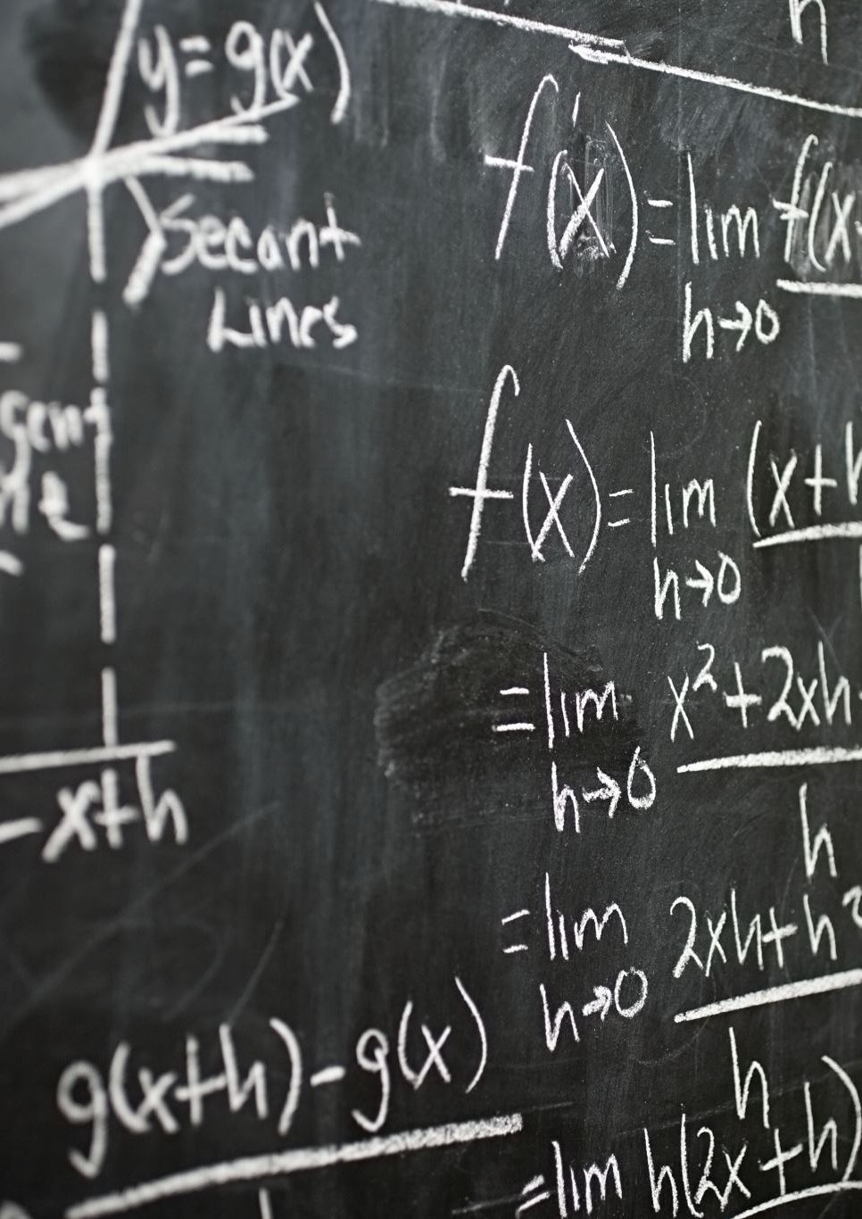

Terminology
Parent/Daughter – “before and after of decay”
Spontaneous – each decay cannot be predicted, but can be modeled statistically
Conservation of Mass and Conservation of Charge
Transition Energy (Q) – decay converts ENERGY TO MASS
  Typically written as: ${}_{Z}^{A}X\underset{→}{Particle:Half−Life}{}_{Z−?}^{A−?}Y + ? + Q$

Slide 5
Radioactive Isotope Chemistry
Chemistry primarily depends on VALENCE electrons
Isotopes have the same base electron shell
Minor relative differences in mass → no difference in chemistry
Major relative differences in mass → some effect on chemistry
Tracers use radioactive isotopes to image the body

Slide 6

Modes of Radioactive Decay
Depeche anyone?

Slide 7
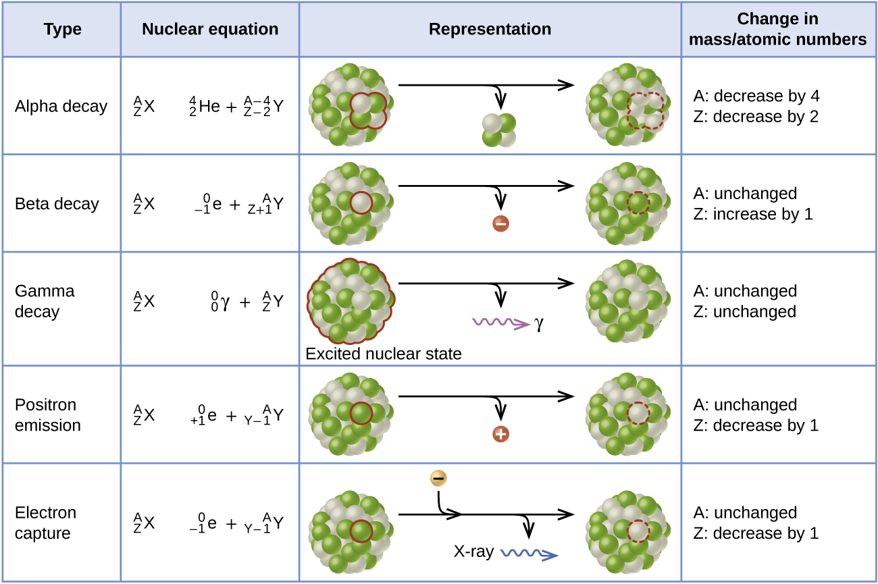
Modes of Radioactive Decay

Slide 8
Modes of Radioactive Decay
Alpha Emission
Beta Emission
Electron Emission
Positron Emission
Internal Conversion
Gamma Emission
Excited States
Isomeric Transition
Electron Capture
Nuclear Fission
We can use the LINE OF STABILITY chart to predict which category of decay is most likely!

Slide 9

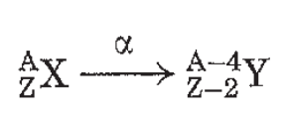
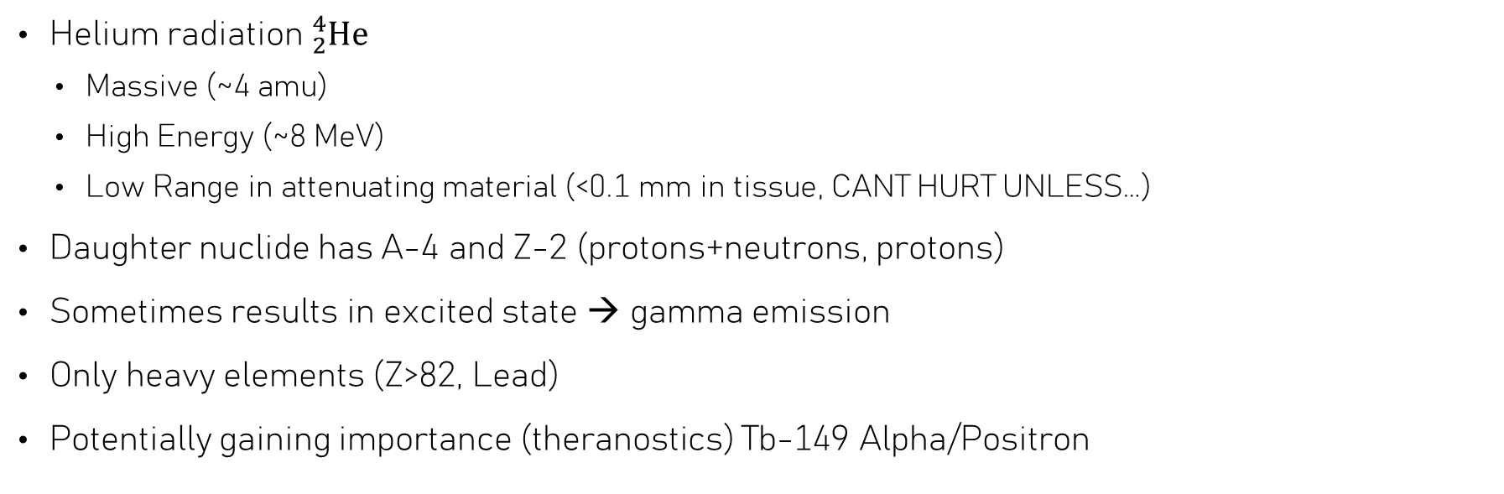
Alpha Emission
Helium radiation ${}_{2}^{4}{\text{He}}$
  Massive (~4 amu)
  High Energy (~8 MeV)
  Low Range in attenuating material (<0.1 mm in tissue, CANT HURT UNLESS…)
Daughter nuclide has A-4 and Z-2 (protons+neutrons, protons)
Sometimes results in excited state → gamma emission
Only heavy elements (Z>82, Lead)
Potentially gaining importance (theranostics) Tb-149 Alpha/Positron

Slide 10
Concept: Alpha Emission Cause
Given what we know about the “tug-of-war” for stability, what is the imbalance that leads to alpha-particle decay?
Repulsive forces are too great (electromagnetic force between protons to great, not enough neutrons to balance things out); this is reflected in the LINE OF STABILITY

Slide 11
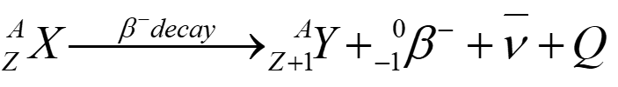
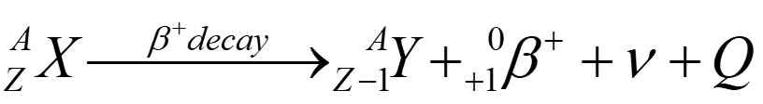
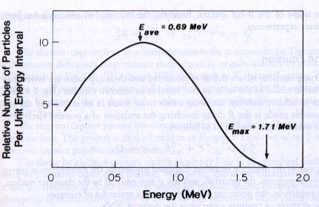

Beta Emission
Beta is overarching term for ELECTRONS ($e^{−}$ or $β^{−}$) and POSITRONS ($e^{+}$ or $β^{+}$)
  Wide range of maximum energies
  Decent range in attenuating material → dangerous!
When beta emission occurs the nucleus GAINS or LOSES charge, respectively (conservation of charge)
Energy Spectrum for emitted electron
Use line of stability to predict what kind of emission
  Too many neutrons: $β^{−}$ → Z+1 and A+0
  Too many protons: $β^{+}$ → Z-1 and A+0
Notes:
In lecture II discuss Annihilation, Decay Scheme Chart

Slide 12
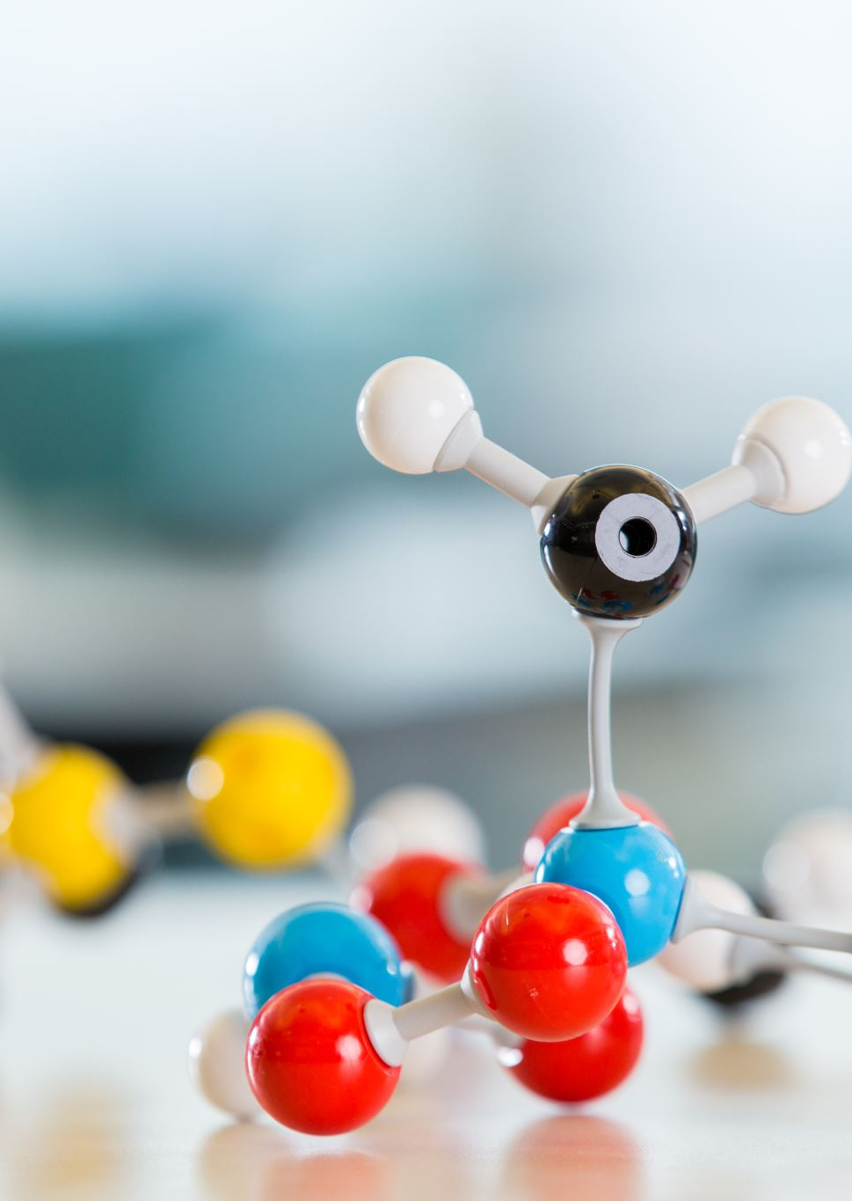
Neutrino and Anti-Neutrino
Basically never interact with matter
  Essentially massless
  No charge
Only importance to us is that it carries away excess energy for BETA decay → spectrum

Slide 13
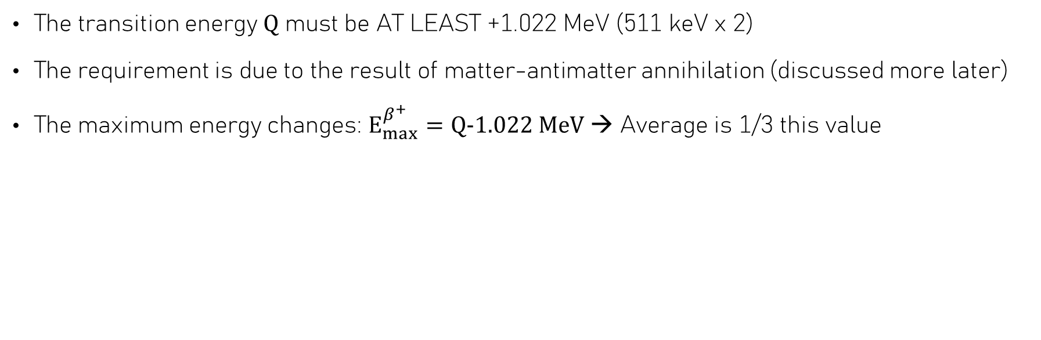
Positron Energy Requirement
The transition energy $Q$ must be AT LEAST +1.022 MeV (511 keV x 2)
The requirement is due to the result of matter-antimatter annihilation (discussed more later)
The maximum energy changes: $E_{max}^{β^{+}}=Q−1.022 \text{MeV}$ → Average is 1/3 this value

Slide 14
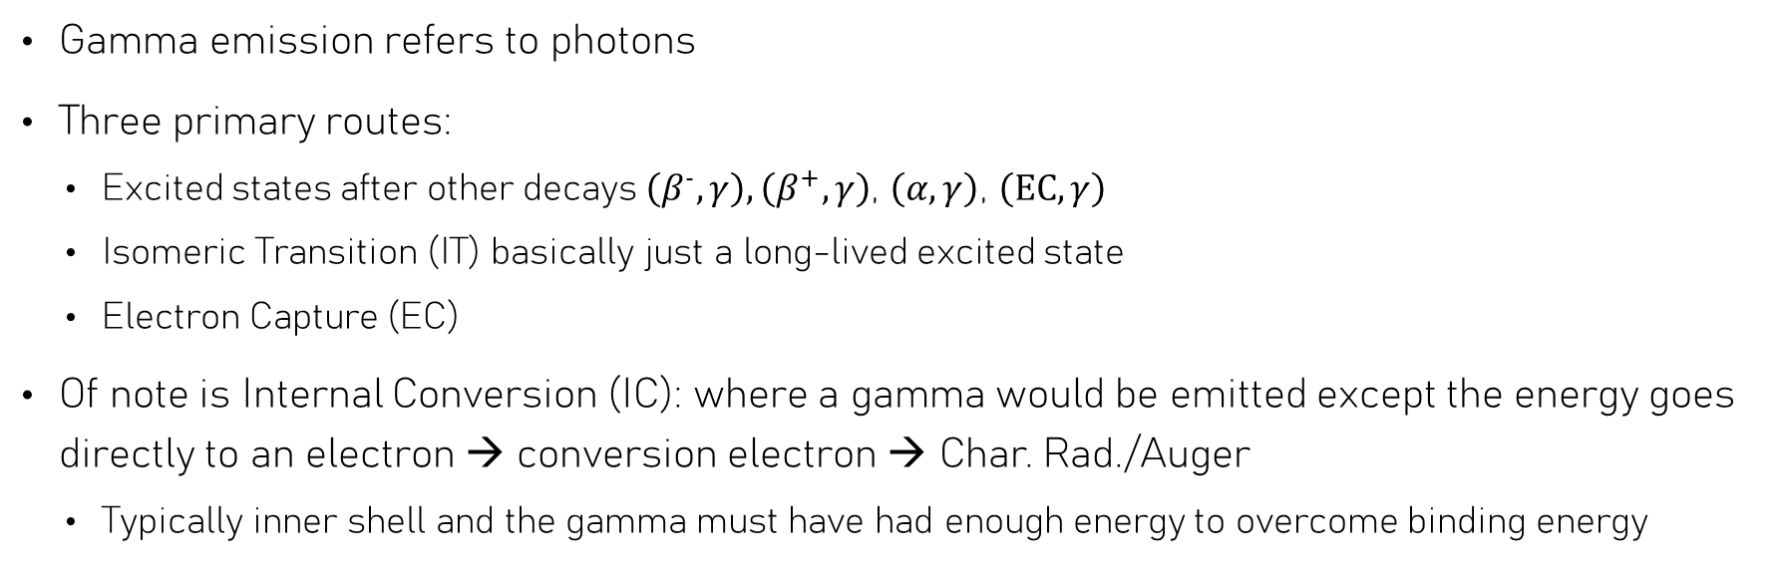
Gamma Emission
Gamma emission refers to photons
Three primary routes:
  Excited states after other decays $\left(β^{−},γ\right),\left(β^{+},γ\right)$, $\left(α,γ\right)$, $\left(EC,γ\right)$
  Isomeric Transition (IT) basically just a long-lived excited state
  Electron Capture (EC)
Of note is Internal Conversion (IC): where a gamma would be emitted except the energy goes directly to an electron → conversion electron → Char. Rad./Auger
  Typically inner shell and the gamma must have had enough energy to overcome binding energy

Slide 15
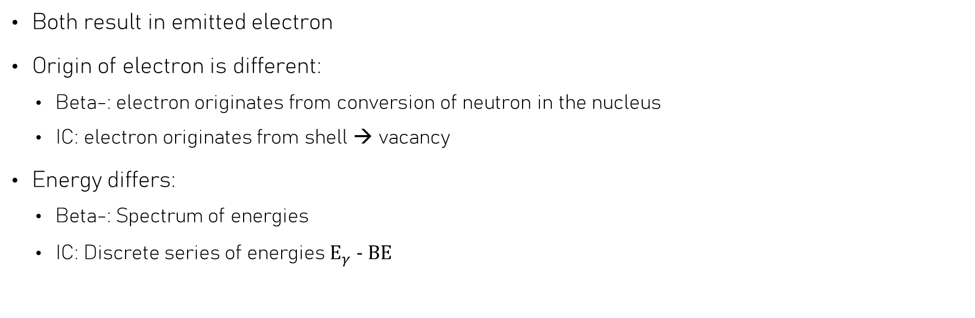

Internal Conversion VS $β$
Both result in emitted electron
Origin of electron is different:
  Beta-: electron originates from conversion of neutron in the nucleus
  IC: electron originates from shell → vacancy
Energy differs:
  Beta-: Spectrum of energies
  IC: Discrete series of energies $E_{γ} − \text{BE}$

Slide 16

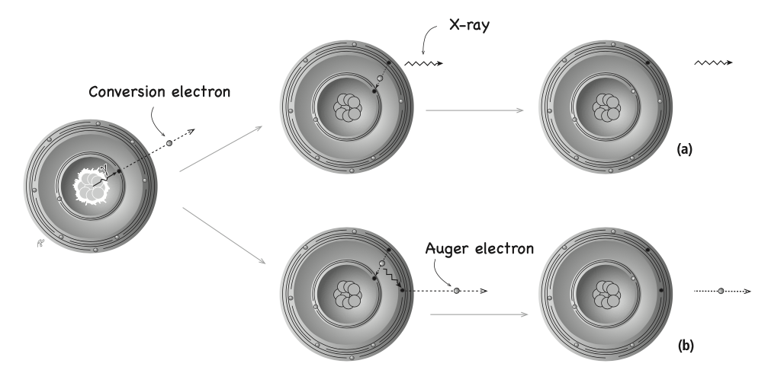
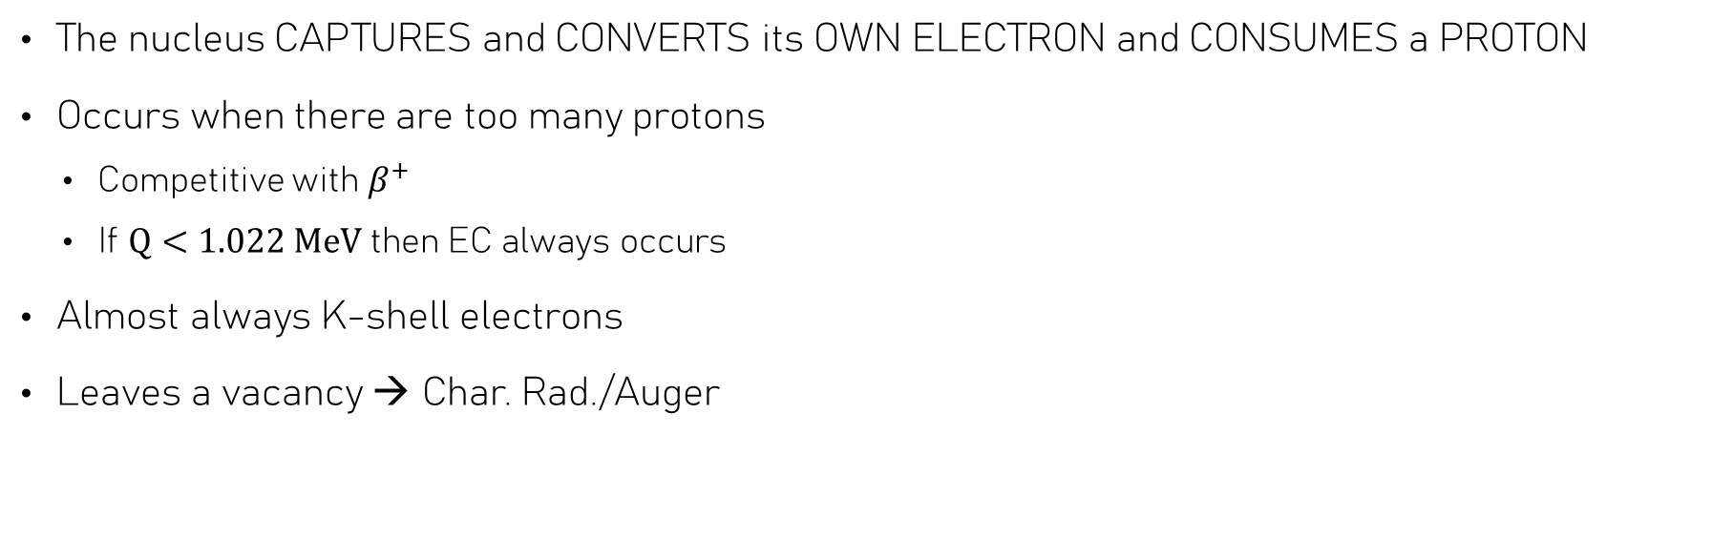
Electron Capture
The nucleus CAPTURES and CONVERTS its OWN ELECTRON and CONSUMES a PROTON
Occurs when there are too many protons
  Competitive with $β^{+}$
  If $Q<1.022 \text{MeV}$ then EC always occurs
Almost always K-shell electrons
Leaves a vacancy → Char. Rad./Auger

Slide 17
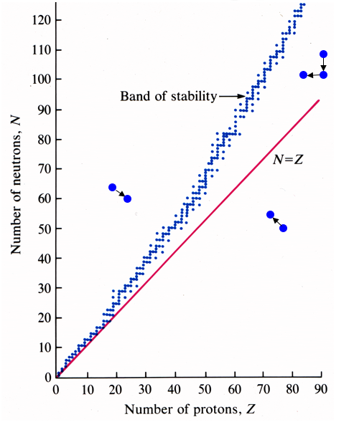



Line of Stability
α -decay (Z-2; N-2; A-4)
β⁻ -decay (Z+1; N-1)
β⁺ -decay (Z-1; N+1)

Slide 18
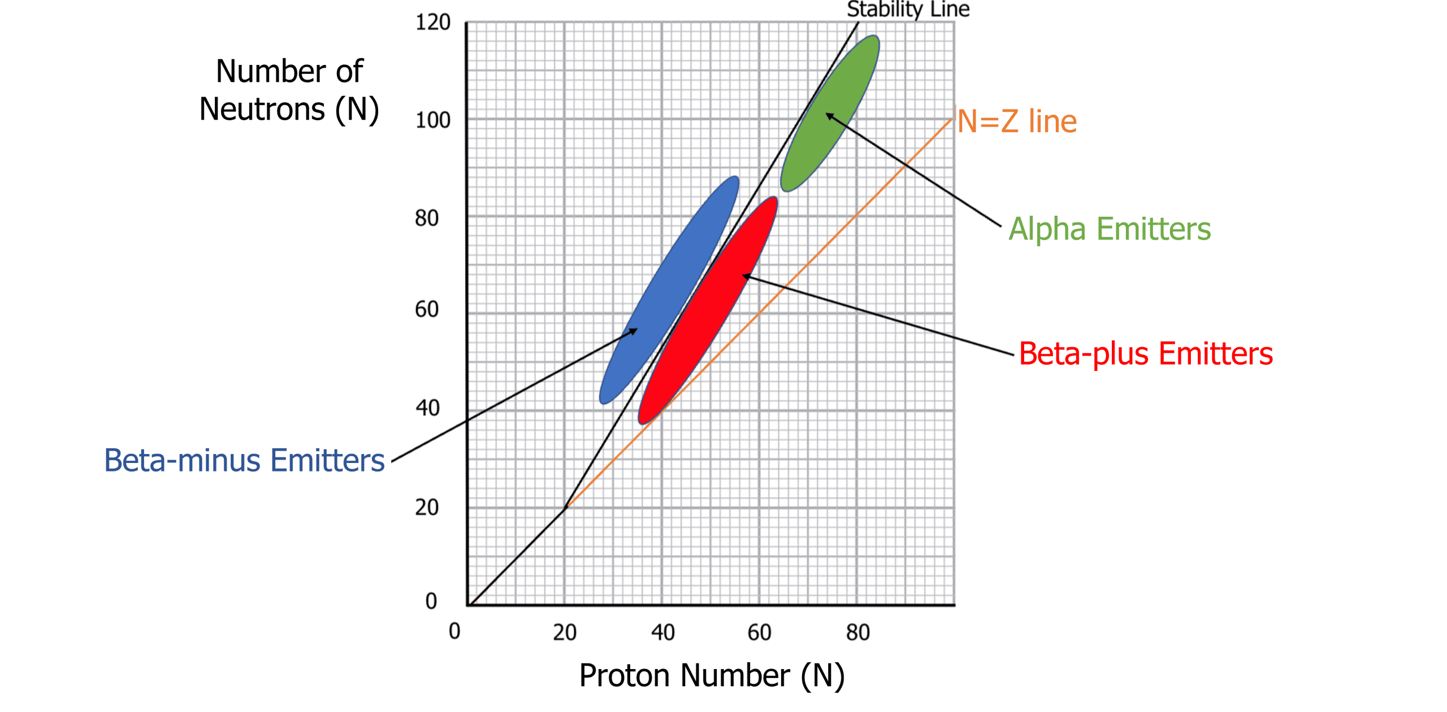
Line of Stability
And EC

